Slide 1


Pharmaceutical Sales Prediction Across Multiple Stores
Predicting pharmaceutical sales across multiple stores is essential for optimizing inventory, allocating resources, and making informed business decisions. Accurately forecasting sales helps pharmaceutical companies meet customer demand and ensure the availability of essential medications.
by vicky saini

Slide 2
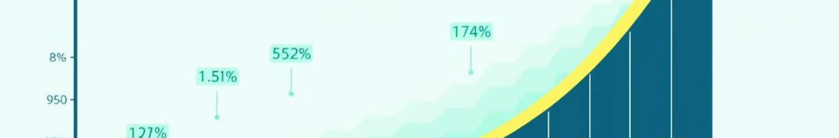
Importance of accurate sales forecasting in the pharmaceutical industry
1
Inventory Management
2
Resource Allocation
Accurate forecasting helps minimize stockouts and excess inventory, reducing costs and ensuring the availability of essential medicines.
Forecasting enables efficient allocation of resources, such as staff, marketing budgets, and distribution channels, to maximize sales potential.
3
Demand Planning
4
Strategic Decision-Making
Predicting sales helps anticipate future demand, allowing companies to adjust production and distribution strategies accordingly.
Forecasting provides valuable insights for making informed business decisions, such as pricing strategies, market expansion, and product development.

Slide 3
Key factors influencing pharmaceutical sales
Demographics
Disease Prevalence
Economic Conditions
Age, gender, location, and health conditions of the population influence demand for specific medications.
The prevalence of diseases, such as diabetes, heart disease, and cancer, drives demand for related medications.
Economic factors like unemployment, inflation, and healthcare spending impact consumer purchasing power and drug affordability.

Slide 4

Challenges in predicting sales across multiple store locations
Data Availability
Local Market Dynamics
Access to consistent and reliable sales data from multiple stores is crucial for accurate predictions, but data inconsistencies and missing values can pose challenges.
Each store operates within a unique local market with distinct demographics, competition, and consumer preferences, making it difficult to generalize sales patterns.
Seasonal Variations
Seasonal fluctuations in demand, influenced by factors like weather, holidays, and public health campaigns, can make it challenging to predict sales accurately.

Slide 5
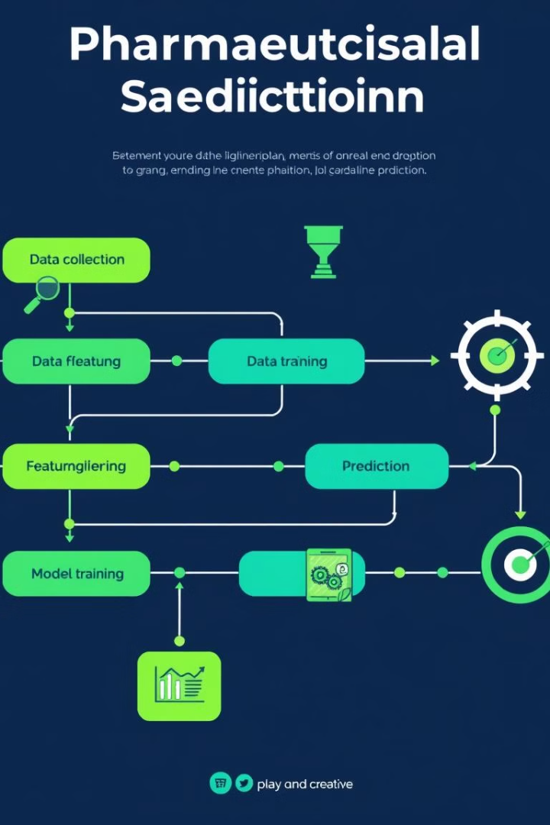
Overview of data sources and collection methods, Data preprocessing and feature engineering
1
Data Sources
Sales data, customer demographics, inventory records, pricing information, and marketing campaign data are key sources.
2
Data Preprocessing
Cleaning, transforming, and handling missing values are essential for preparing data for analysis.
3
Feature Engineering
Creating new features, such as lagged sales, promotional indicators, and seasonal indices, improves model accuracy.

Slide 6
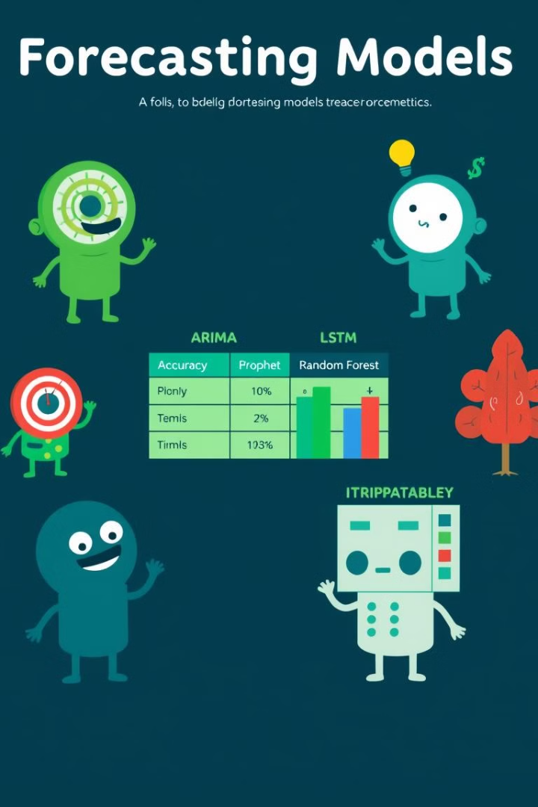
Comparative analysis of forecasting models
Model
Accuracy
Computational Cost
Interpretability
ARIMA
High
Low
High
LSTM
Very High
High
Low
Prophet
High
Moderate
High
Random Forest
Moderate
Moderate
Moderate

Slide 7
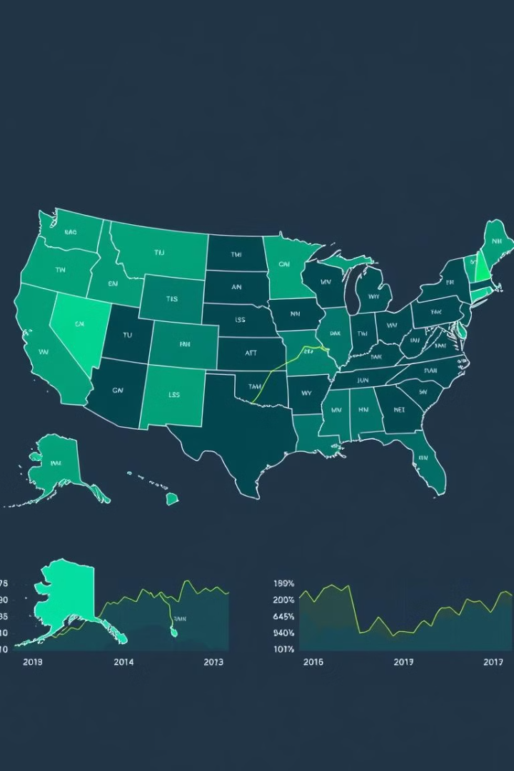



Incorporating regional and seasonal trends
Regional Trends
Identifying regional differences in sales patterns, such as population density, healthcare infrastructure, and consumer preferences, is important.
Seasonal Trends
Incorporating seasonal variations, such as flu season, summer vacations, and holiday promotions, into forecasting models is crucial.
Model Adjustment
Adjusting forecasting models to account for regional and seasonal variations leads to more accurate predictions.

Slide 8
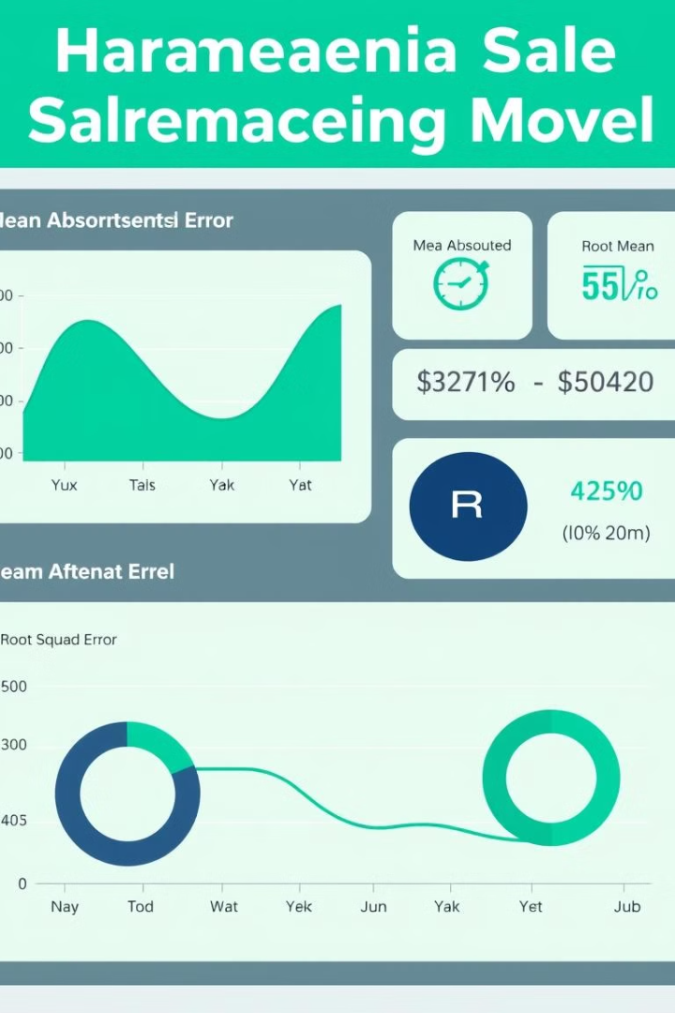



Evaluating model performance and accuracy
Accuracy Metrics
Evaluating model performance using metrics such as mean absolute error (MAE), root mean squared error (RMSE), and R-squared helps assess the model's predictive power.
Visualization
Visualizing forecast results and comparing them to actual sales data provides insights into model performance and identifies areas for improvement.
Model Tuning
Fine-tuning model parameters and exploring different forecasting techniques based on performance evaluation can enhance prediction accuracy.

Slide 9
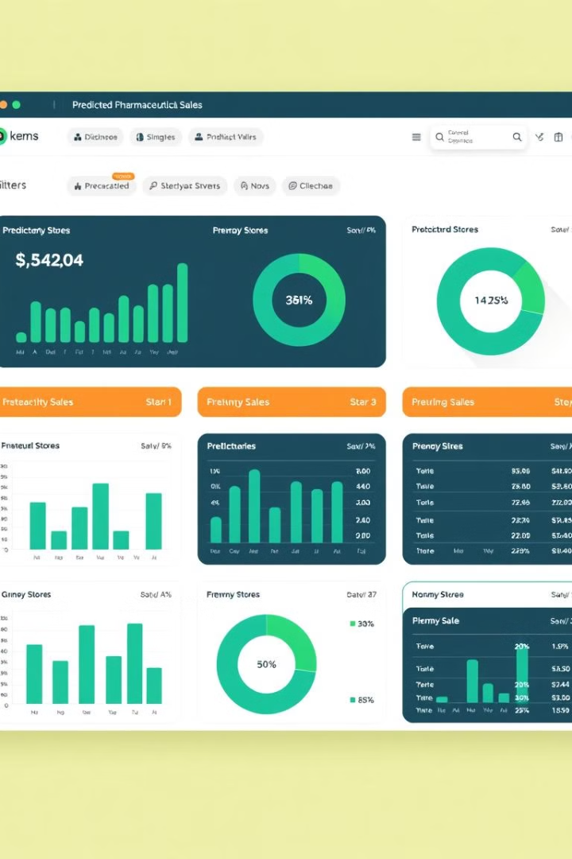
Insights and recommendations for improving sales prediction, Serving predictions on a web interface using streamlit
1
Data Quality
2
Feature Selection
Ensuring data accuracy, completeness, and consistency is essential for reliable predictions.
Identifying and selecting relevant features that significantly impact sales is crucial for model accuracy.
3
Model Selection
4
Streamlit Interface
Choosing the most appropriate forecasting model based on data characteristics and desired prediction accuracy is important.
Creating a user-friendly web interface using Streamlit enables stakeholders to interact with predictions and visualize sales trends.

Slide 10

Conclusion and future considerations
Accurate pharmaceutical sales prediction is crucial for optimizing operations and making informed decisions in the industry. Continuously improving data quality, exploring advanced forecasting techniques, and leveraging data visualization tools are key to enhancing predictions and driving business success.

